Slide 1
Hertz Corporation
Team D:Ashley Metz, Nathan Bachmeier, Syreeta Essex, Maria Talamante, Erica, Tyler Wiese
August 17, 2015
HCS521
David Rollins

Slide 2
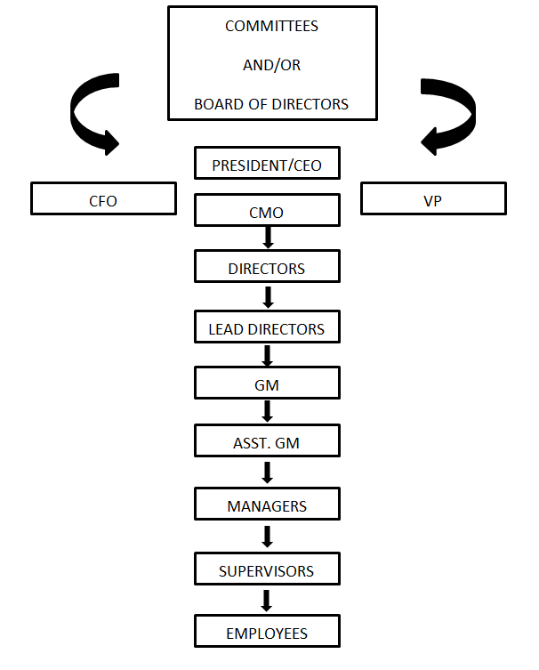
Hertz Co. Organizational Chart
Notes:
Hertz Corporation is an extremely large international company. The company’s focus is in the rental business. The rental business includes car rentals, equipment rental, machinery and tool rental, and fleet rentals. Their main business is located in North America, Europe, and the Middle East. They are an ever growing company always partnering with other companies to gain market share.
Hertz Corporation’s parent company is Ford Motor Company (Marketline, 2014). It is also a publicly traded company using HTZ as their trading initials on the NYSE. Hertz has many world-wide locations, which are either owned by Hertz, franchise locations, or partnered locations. Hertz owns the rental car companies Dollar Rent A Car, Thrifty Car Rental, Advantage, and Firefly (Marketline, 2014). Their business is split between airport rental locations and off site locations. Hertz also operates their equipment rental, machinery and tool rental, and fleet rentals the same way. That is through partnerships, franchise locations, or their direct employees.
Hertz has a very top down organizational structure with CEO’s, CFO’s, Directors, Lead Directors, and etc. down the chain of command. The organization has conflict issues and they are horizontal and vertical. The vertical issues arise between line staff and staff management, and between departments (Shetty, 2011). The horizontal conflicts arise between the departments wanting the same resources (Shetty, 2011). Problems and conflicts arise within any corporation, but they can be resolved leading to a better more efficient company.

Slide 3
References
Marketline. 30 Dec. 2014. F8402753-95E7-4937-B825-4537A1CB52A
Shetty, Netra. Organisational Structure of the Hertz Corporation. Feb. 4, 2011. http://www.managementparadise.com/forums/human-resources-management-h-r/21493/-organizational-structure-hertz-corporation.html

